Slide 1
EXECUTIVE SUMMARY
Our company has been running multiple marketing campaigns across various channels (Facebook, Instagram, Pinterest) to promote our products. We have collected detailed data on daily ad performance, including metrics like impressions, clicks, spend, conversions, and engagement (likes, shares, comments). This project aims to analyze this data to gain insights into the effectiveness of our campaigns, optimize our ad spend, and improve future marketing strategies.

Slide 2
INSIGHTS
1. Campaign Performance
2. Channel Effectiveness
3. Geographical Insights
4. Device Performance
5. Ad-Level Analysis
6. ROI Calculation
7. Time Series Analysis

Slide 3
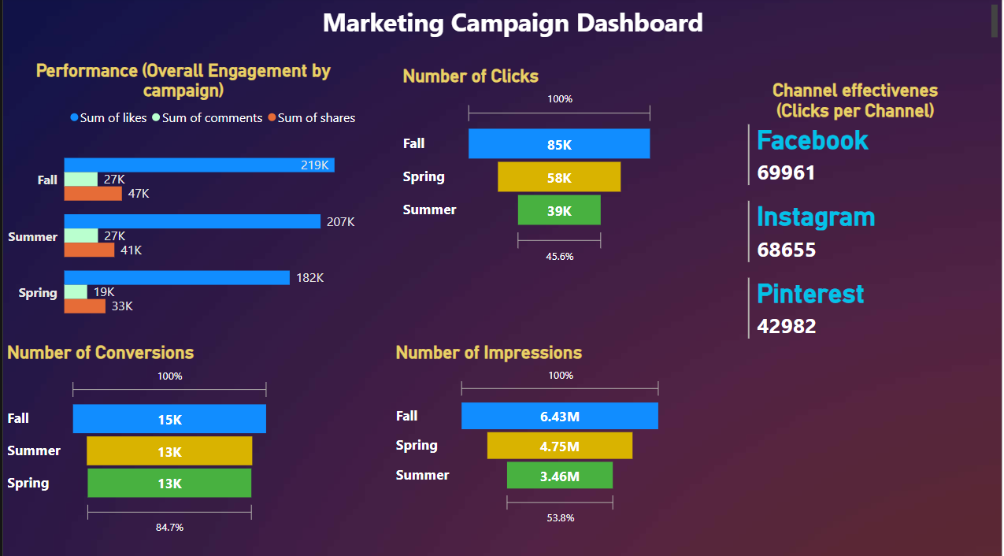
KEY POINTS
OBJ 1
Overall campaign performance was highest in Fall based on the metrics assessed.
Metrics Include:
Likes – 219K
Comments – 27K
Shares – 47K
Clicks – 85K
Conversions – 15K
Impression – 6.43M
OBJ 2
Facebook was the most effective channel with approximately 70K Clicks

Slide 4
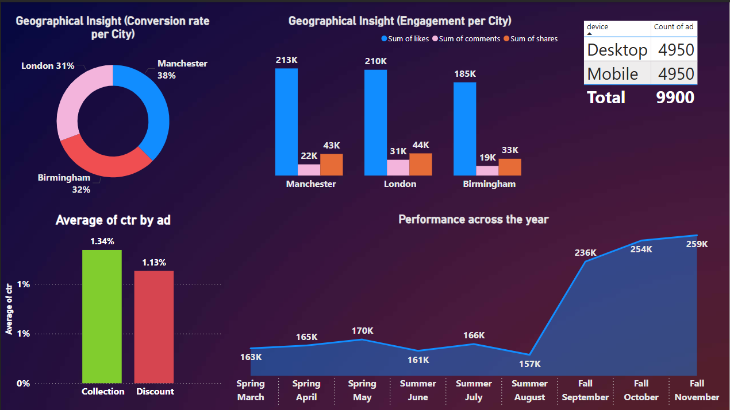
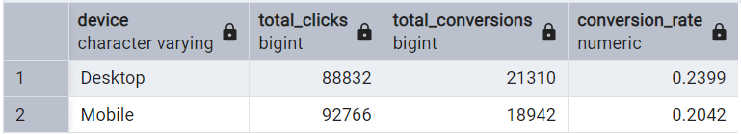
KEY POINTS
OBJ 3
Manchester is the city with the highest likes “213K”.
However, London has the highest engagement rate with 31K Comments & 44K Shares
Manchester is the city with the highest conversion rate of 38%.
OBJ 4
Desktop had the highest rate of conversion with 24%
AD Level Analysis

Slide 5
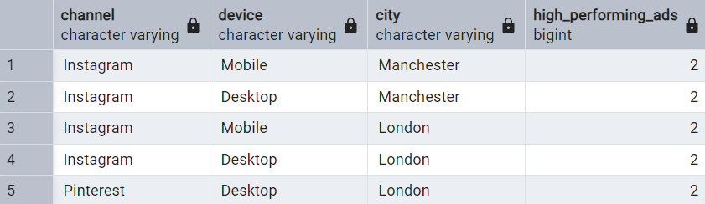
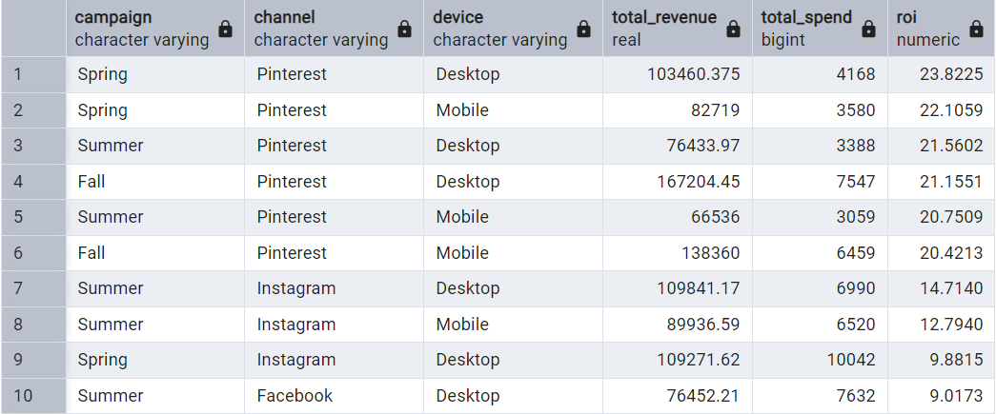
Charactersistics
AD Level Analysis
ROI

